Slide 1


Justin Ngo
5/18/2022

Slide 2

Outline
Executive Summary
Introduction
Methodology
Results
Conclusion
Appendix

Slide 3
Executive Summary
Summary of methodologies
Data collection – Web Scraping & API
Data wrangling
EDA with data visualization
EDA with SQL
Interactive Folium Map
Dashboard with Plotly Dash
Machine Learning Model – Predictive analysis
Summary of all results
Exploratory data analysis results
Interactive Map analysis

Slide 4
Introduction
Project background and context
SpaceX advertises Falcon 9 rocket launches on its website, with a cost of 62 million dollars; other providers cost upward of 165 million dollars each, much of the savings is because SpaceX can reuse the first stage. Therefore if we can determine if the first stage will land, we can determine the cost of a launch. This information can be used if an alternate company wants to bid against SpaceX for a rocket launch.
Problems you want to find answers
Identify correlations between successful landing rate, booster versions, and payload.
Identify conditions to get the highest successful launch rates.

Slide 5

Section 1

Slide 6
Methodology
Executive Summary
Data collection methodology:
SpaceX Web scraping and API
Perform data wrangling
Converted outcomes into training labels for booster successfully and unsuccessfully landed.
Perform exploratory data analysis (EDA) using visualization and SQL
Perform interactive visual analytics using Folium and Plotly Dash
Perform predictive analysis using classification models
Found best Hyperparameters for Logistic Regression, Classification Trees and SVM

Slide 7
Data Collection
Data was collected through processes of web scraping from the Wikipedia page – SpaceX, Falcon9 and Falcon Heavy Launches Records and API requests from the SpaceX API.
You need to present your data collection process use key phrases and flowcharts
Web Scraping SpaceX API
Get HTML response from Wikipedia page
Extract data using beautiful soup
API receives SpaceX data in .JSON file
Normalize the data into CSV file
Request data from SpaceX API
Normalize the data into CSV file

Slide 8
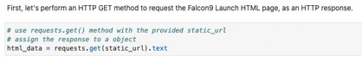
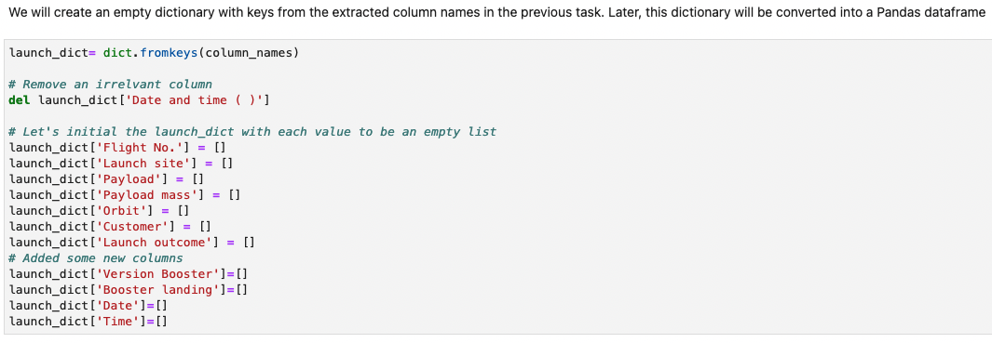
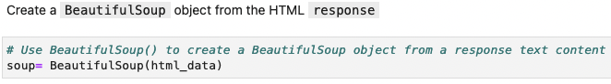
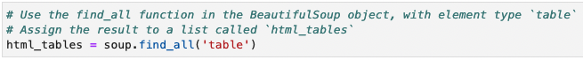
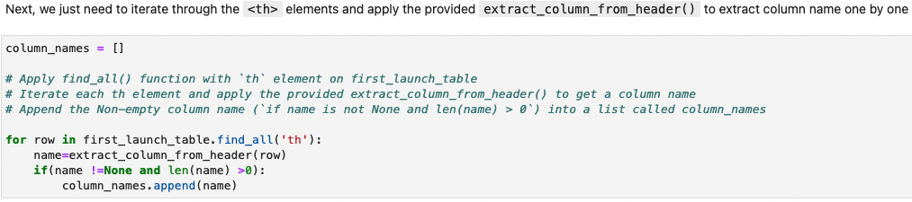
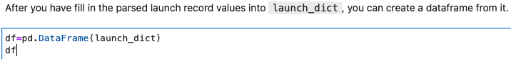
Data Collection - Scraping
1]
2]
3]
4]
5]
6]Next, we just need to fill up the launch_dict with launch records extracted from table rows.
Usually, HTML tables in Wiki pages are likely to contain unexpected annotations and other types of noises, such as reference links B0004.1[8], missing values N/A [e], inconsistent formatting, etc.
7]
https://github.com/justbuildin/IBM-Data-Science-Program-/blob/main/1.jupyter-labs-webscraping.ipynb

Slide 9
Data Collection - Scraping
Perform an HTTP GET method to request the Falcon9 Launch HTML page, as an HTTP response
Find all the tables from the webpage with the find_all function and assign it to a list (html_tables)
Create a BeautifulSoup object from the HTML response
Extract column names by using the find_all() function and extract_column_from_header
Create an empty dictionary with the column names extracted
Add (append) the data into the new table
Create a data frame and export it to CSV
https://github.com/justbuildin/IBM-Data-Science-Program-/blob/main/1.jupyter-labs-webscraping.ipynb

Slide 10
Data Collection – SpaceX API
Request rocket launch data from API
Convert response to a JSON file
Request and parse the data with GET request
Use json_normalize method to convert the json result into a dataframe
Create new dataset with the data we have obtained. Combine columns of data into a dictionary.
Create a pandas data frame
Filter out Falcon 1 launches and create a new data frame with online Falcon 9 launches
Export new data frame to CSV.
https://github.com/justbuildin/IBM-Data-Science-Program-/blob/main/2.jupyter-labs-spacex-data-collection-api.ipynb

Slide 11
Data Wrangling
Calculated number of launch sites
Calculated the number and occurrence of mission outcome per orbit type
Create a landing outcome label from Outcome column where the Vlass value would be 0 for bad outcome and 1 otherwise.
Created a set of outcomes where the second stage did not land successfully
https://github.com/justbuildin/IBM-Data-Science-Program-/blob/main/3.labs-jupyter-spacex-Data%2520wrangling.ipynb
Calculated the (mean) success rate for every landing in the dataset

Slide 12
EDA with Data Visualization
Scatter Plot Charts:
(X) Flight Number vs (Y) Pay Load Mass
(X) Flight Number vs (Y) Launch Site
(X) Pay Load Mass vs (Y) Launch Site
(X) Flight Number vs (Y) Orbit
(X) Pay Load Mass vs (Y) Orbit
Scatter plot shows how much one variable is effected by another so we can examine the correlation.
Bar Chart:
(X) Success Rate vs (Y) Orbit Type
Bar charts make it easier to compare datasets at a glance between multiple groups.
Line Chart
(X) Year vs (Y) Average Success Rate
Line charts shows data variables and trends clearly and help predict future results.
https://github.com/justbuildin/IBM-Data-Science-Program-/blob/main/4.jupyter-labs-eda-dataviz.ipynb

Slide 13
EDA with SQL
Loaded Dataset into table on DB2.
Executed SQL queries to answer following questions
Show names of unique launch sites
Show 5 records where launch sites begin with the string 'CCA'
Display the total payload mass carried by boosters launched by NASA (CRS)
Display average payload mass carried by booster version F9 V1.1
List the date when the first successful landing outcome on a ground pad was achieved
List the names of the boosters which have success in drone ship landings and have a payload mass between 4000 and 6000
List the total number of successful and failure mission outcomes
List the names of the booster versions which have carried the maximum payload mass
List the records which will display the date, failure landing outcomes on a drone ship, booster version and launch sites for the year of 2015.
Rank the count of successful landing outcomes between 04-06-2010 and 20-03-2017 in descending order
https://github.com/justbuildin/IBM-Data-Science-Program-/blob/main/5.jupyter-labs-eda-sql-coursera_sqllite.ipynb

Slide 14
Build an Interactive Map with Folium
Added marks to launch sites on a map
Marked the successful/ failed launches for each site on the map
Lines used to calculate distances between launch site and local proximities.
These marks were made so we could visualize relationship of successful/ failed launches based on location. Also so we could visualize the distance between launch site and civilian populated areas.
https://github.com/justbuildin/IBM-Data-Science-Program-/blob/main/6.lab_jupyter_folium_launch_site_location.ipynb

Slide 15
Build a Dashboard with Plotly Dash
The dashboard contains a pie chart and a scatter chart.
Pie chart
Shows total successful launches by site.
Scatter chart
Shows the relationship between launch outcomes and payload mass (kg) for different booster versions.
https://github.com/justbuildin/IBM-Data-Science-Program-/blob/main/7.spacex_dash_app.py

Slide 16
Predictive Analysis (Classification)
Performed exploratory data analysis and determined training labels
Created a column for the class
Standardized the data
Split into training data and test data
Found best hyperparameters for SVM, classification trees and logistic regression
Found the method that performs best using test data
https://github.com/justbuildin/IBM-Data-Science-Program-/blob/main/8.jupyter_SpaceX_Machine%2520Learning%2520Prediction_Part_5.ipynb
Evaluating model
Build Model
Find the best performing model
Improve the model

Slide 17
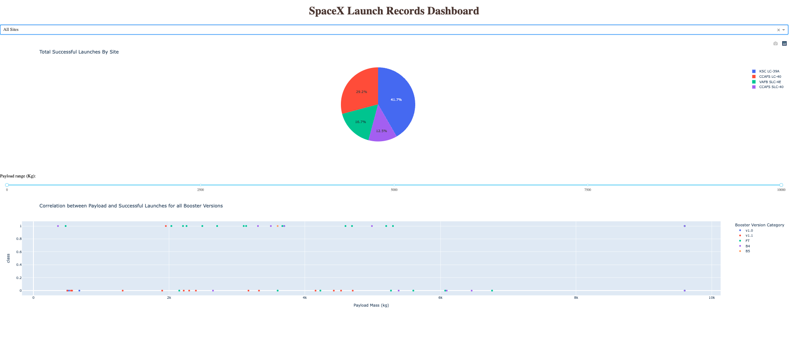
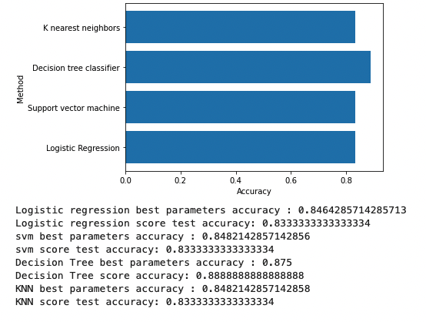
Results

Slide 18

Section 2

Slide 19
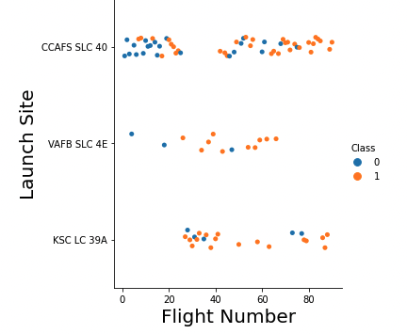
Flight Number vs. Launch Site
Class 0 (blue) are failed launches
Class 1 (orange) are successful launches
This graph shows that over the course of more flight attempts SpaceX was able to achieve more successful launches.

Slide 20
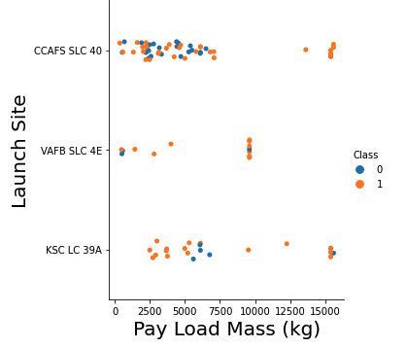
Payload vs. Launch Site
Class 0 (blue) are failed launches
Class 1 (orange) are successful launches
This graph shows that a majority of the flights that failed were below 7500 kg. It seems like the earlier flights were carrying lower payloads before SpaceX ironed out the issues.

Slide 21
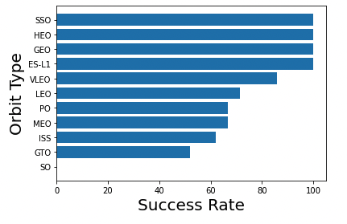
Success Rate vs. Orbit Type
This chart shows that launches going for orbit SSO, HEO, GEO, and ES-L1 had perfect success rates
Launches for orbit GTO had the lowest success rate at around 50%

Slide 22
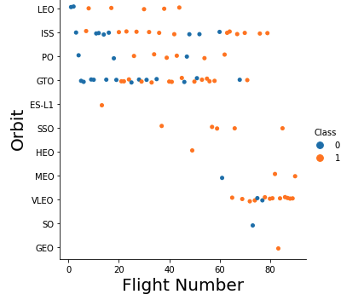
Flight Number vs. Orbit Type
Class 0 (blue) are failed launches
Class 1 (orange) are successful launches
This chart shows flight number and orbit type. Overtime it seems that SpaceX tried for different orbit types in the more recent launches.

Slide 23
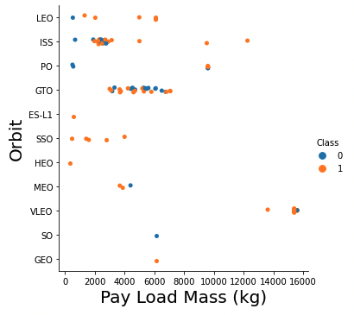
Payload vs. Orbit Type
Class 0 (blue) are failed launches
Class 1 (orange) are successful launches
This chart shows Payload mass and orbit type. We can see that for certain orbit types smaller payloads were sent. VLEO is where the largest payloads were sent.

Slide 24
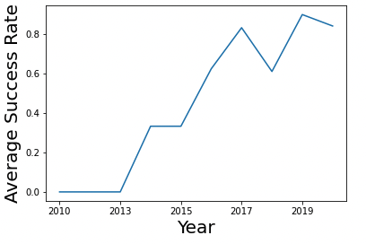
Launch Success Yearly Trend
This chart shows average success rate through the last decade. We can see that the average success rate has increased over time.

Slide 25
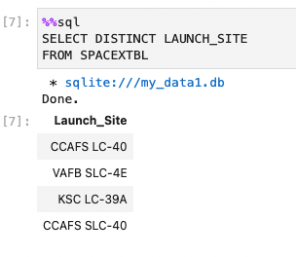
All Launch Site Names
This SQL query pulls all the unique launch sites from the data table

Slide 26
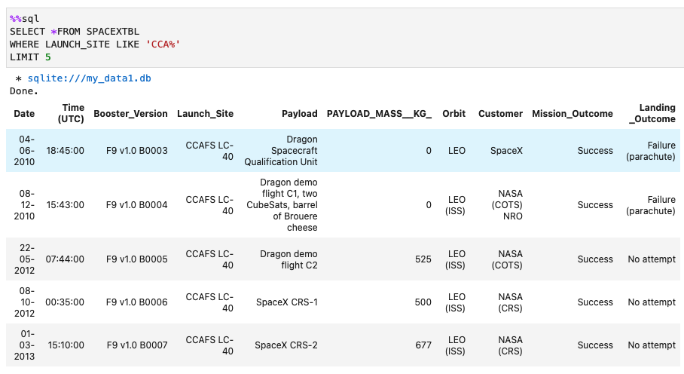
Launch Site Names Begin with 'CCA'
This query shows the first 5 rows of the table with launch sites that begin with 'CCA'

Slide 27
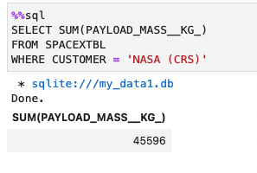
Total Payload Mass
This query shows the total payload carried by boosters from NASA

Slide 28
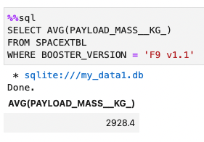
Average Payload Mass by F9 v1.1
This query calculates the average payload mass carried by booster version F9 v1.1

Slide 29
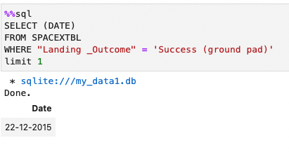
First Successful Ground Landing Date
This query shows the date of the first successful landing outcome on ground pad

Slide 30
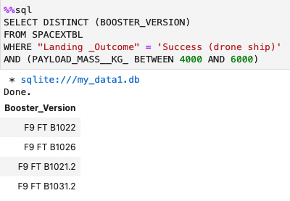
Successful Drone Ship Landing with Payload between 4000 and 6000
This query lists the names of booster versions which have successfully landed on drone ship and had payload mass greater than 4000 but less than 6000

Slide 31
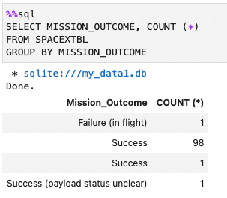
Total Number of Successful and Failure Mission Outcomes
This query calculates the total number of successful and failure mission outcomes

Slide 32
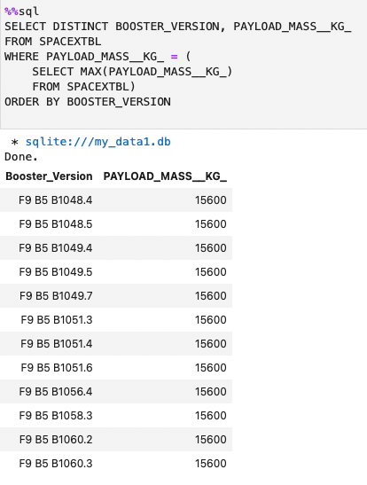
Boosters Carried Maximum Payload
This query lists the names of the booster versions which have carried the maximum payload mass

Slide 33
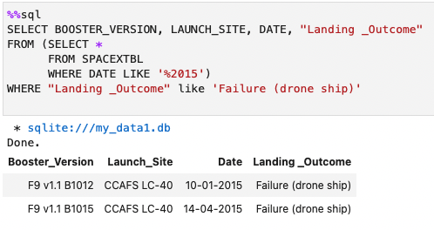
2015 Launch Records
This query lists the failed landing_outcomes in drone ship, their booster versions, and launch site names for in year 2015

Slide 34
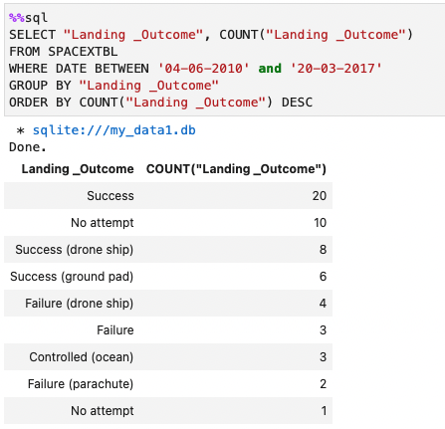
Rank Landing Outcomes Between 2010-06-04 and 2017-03-20
This query ranks the count of landing outcomes (such as Failure (drone ship) or Success (ground pad)) between the date 2010-06-04 and 2017-03-20, in descending order

Slide 35

Section 3

Slide 36
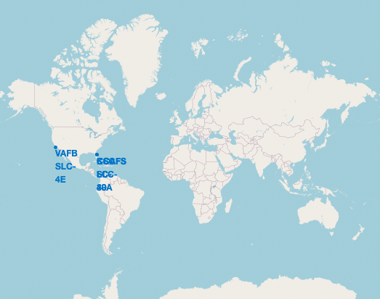
SpaceX Launch Site Locations
Launch sites are all located on the coast in the United States

Slide 37
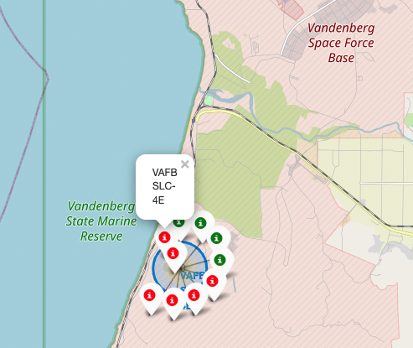
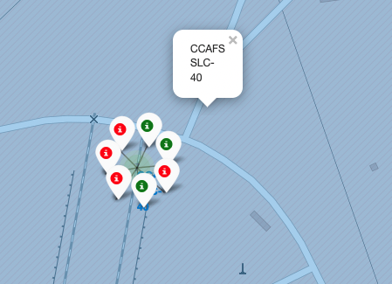
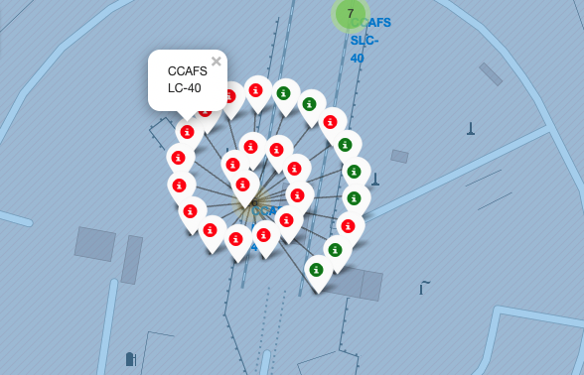
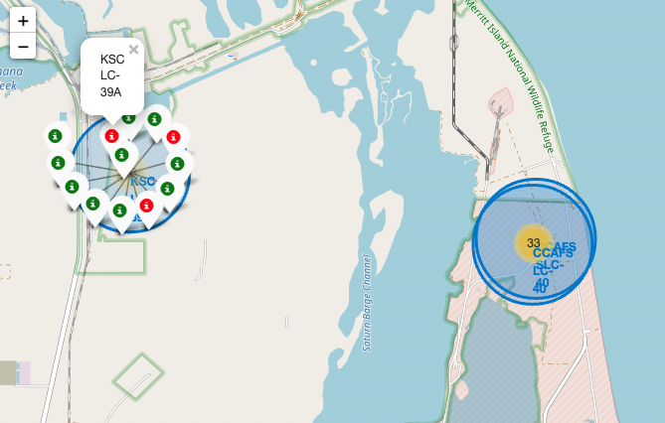
Color-Labeled Launch Outcomes
The first picture on the left is in California at Vandenberg Space Force Station. The three pictures on the right are in Florida at Cape Canaveral Space Force Station.
Green markers are successful landings and the red markers are failed landings.
Far more launches are based in Florida at the Cape Canaveral Space Force Station.

Slide 38
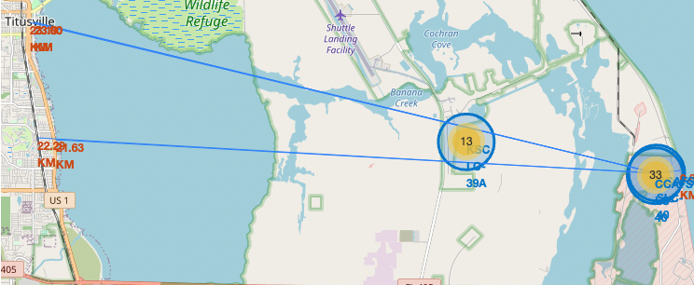
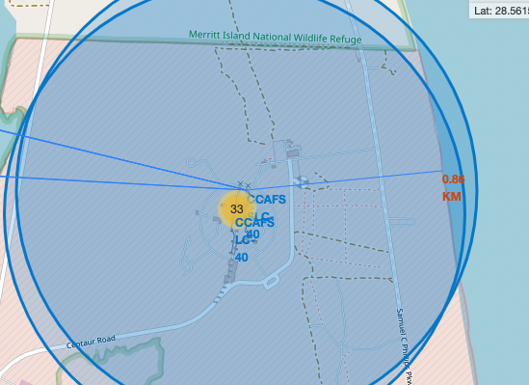
Proximities of Launch Site to Civilian Areas
The launch site is close to the coastline and approximately 22 KM from civilian areas so launch failure is not a threat.

Slide 39

Section 4

Slide 40
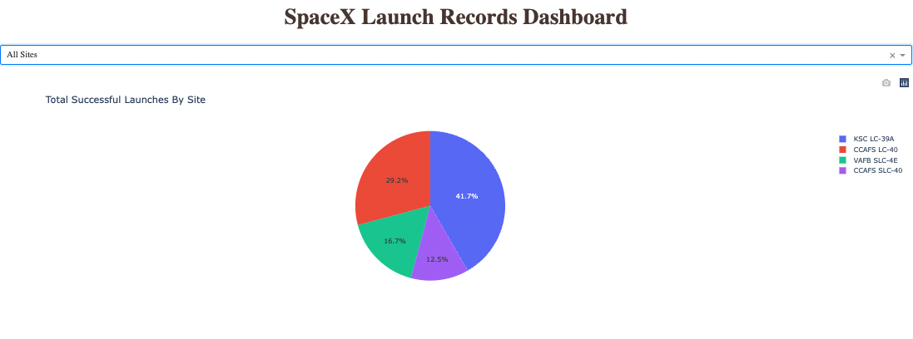
Total Successful Launches By Site
KSC LC-39A had the most with10 successful launches which came out to 41.7% of the total successful launches
There were a total of 24 successful launches.

Slide 41
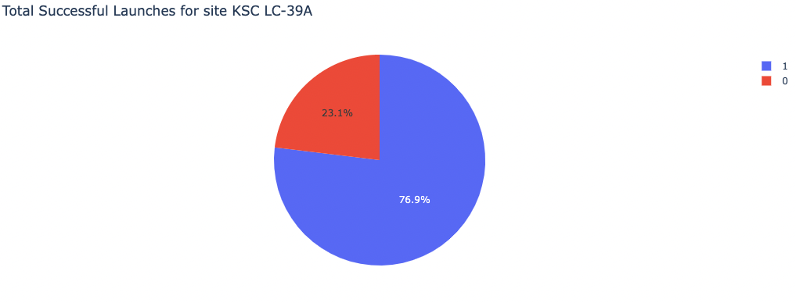
Launch Site With The Highest Launch Success Ratio
KSC LC-39A had 10 successful launches with 3 failed launches

Slide 42
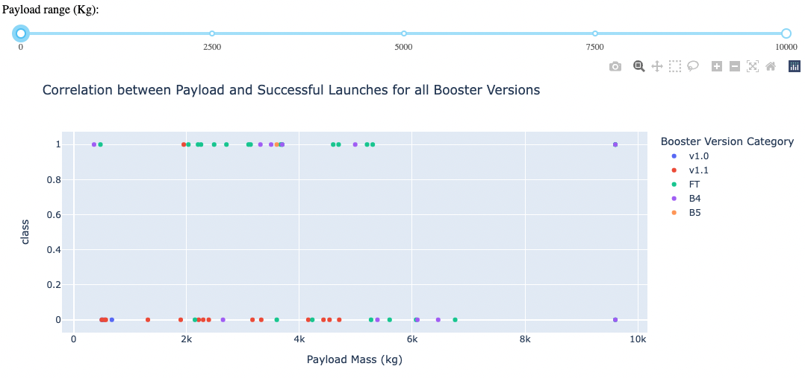
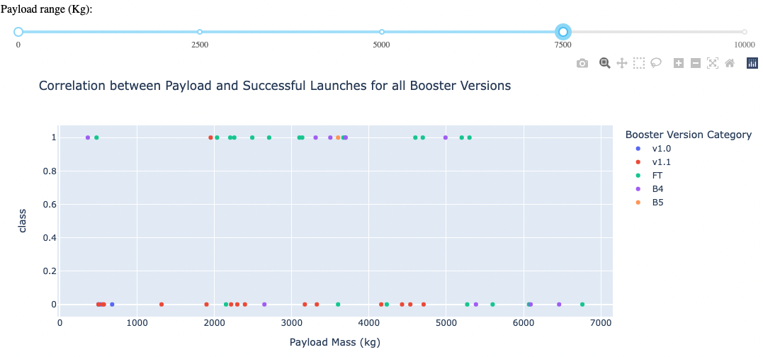
Payload vs Launch Outcome Scatter Plot
The scatter plot shows that a majority of the successful flights were with payloads of 2000 – 5000 KG.

Slide 43

Section 5

Slide 44
Classification Accuracy
Decision Tree classifier had the highest accuracy. There is only 18 samples used in the model though.

Slide 45
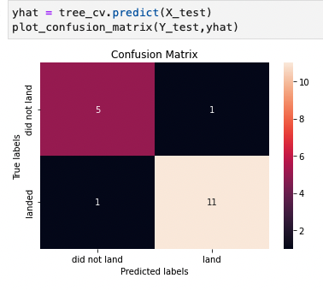
Confusion Matrix
This is the confusion matrix for the decision tree model.
The model predicts 11 successful landings when the 'True labels' are landed.
11 True positives, 5 true negatives, 1 false positive and 1 false negative.

Slide 46
Conclusions
As the number of flights increase the success rate increases as well. Success rate as surpassed 80%
Orbits SSO, HEO, GEO, AND ES-L1 have perfect success rates. 100%.
Launch sites are close to the coastline, but try to be separated from civilian areas.
KSC LC-39A has the highest launch success rate as well as the highest number of successful launches.
Launch success rates are higher than that of heavy payload launches.
Decision tree matrix delivered the highest accuracy however the sample data size is small at 18 samples.
Based on these findings competitors in the space industry need to find ways to reuse their rockets as well if they want to compete or even exist along with SpaceX.

Slide 47
Appendix
https://github.com/justbuildin/IBM-Data-Science-Program-

Slide 48


